Slide 1
Alperen Gündogan
Highlights
Education
Experience
Projects
Master thesis
Notes:
I have prepared a small presentation about myself, which takes around 10 minutes. I will mention about my education, experience, projects and master thesis.

Slide 2
Education
Technical University of Munich, DE (2017-2020)
M. Sc. in Communication Engineering, high honors
DAAD Scholarship
Istanbul Technical University, TR (2012 - 2017)
B. Sc. in Electronics and Communication Engineering, high honors
Technical University of Ostrava, CZ (2015 - 2016)
Erasmus exchange
Notes:
I did my bachelor in Turkey about ... Then, I came to Germany for master degree and studied Communication Engineering. I have completed my master in March this year.

Slide 3
Working Experience
Nomor Research (Apr 18 - July 20)
Working Student (Apr 18 – Aug 19)
Implementation of the latest 5G/NR standards into the 5G system simulator.
Internship (Aug 18 – Oct 18)
Design and implementation of 5G-V2X Communication
Protocol Stack design(PHY, MAC, RLC, PDCP, RRC layers) for V2X.
Master Thesis Project (Aug 19 – Mar 20)
Software/Research Engineer (Apr 20 – July 20)
Developing system and link-level standard-compliant simulation tools. Participating on research activities and actively taking part in 3GPP RAN1 standardization process.
Simulation automation
Docker orchestration.
Distributed job queue.
Notes:
In this slide, I only put my experiences in the last 2 years.
I have started to work at Nomor as a working student.
After I finished my thesis, I have started to work at Nomor as a Software/Research Engineer. My job was to develop system and link-level simulation tools and participare in 3GPPP standardizaation process.
Because of the acquiring, we did not get any further projects but I was responsible to create simulation automation tool, so that we can also use it in Nokia for system-level simulations. Simply, the idea is to create a cluster from simulation PCs so that we can manage, control the simulations on various PCs easily.

Slide 4
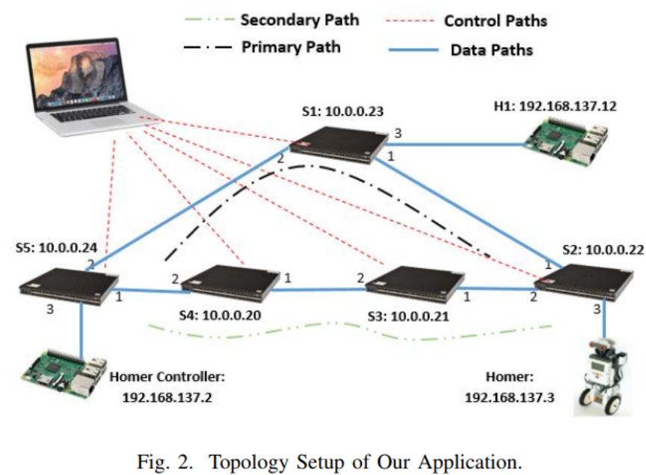
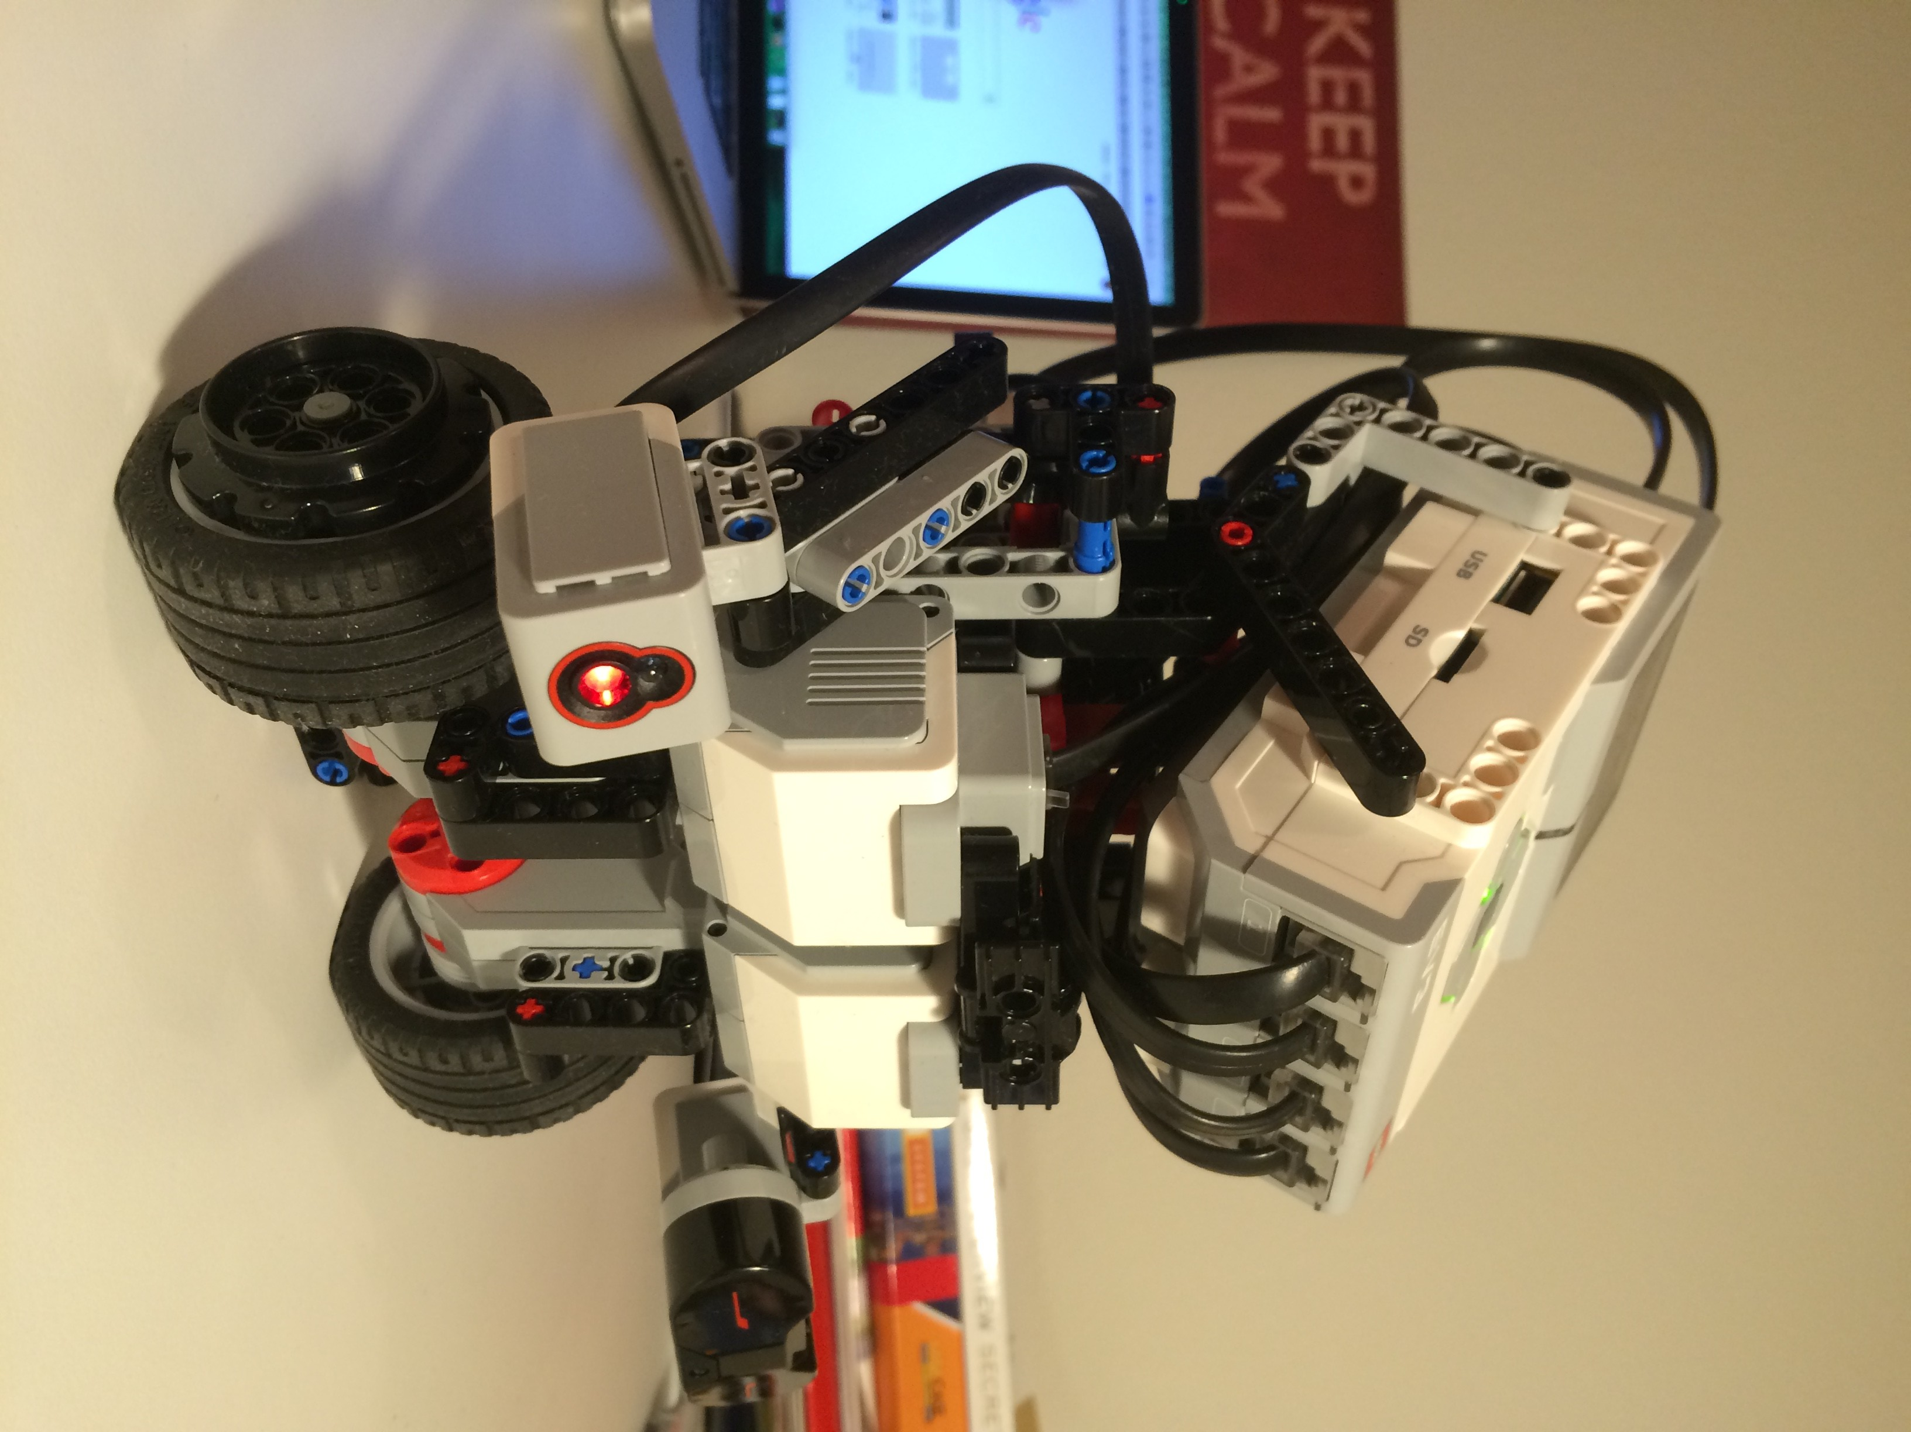
Projects
Software Defined Networks (Summer 18)
Measurement-based QoS mechanisms
Source: https://github.com/gundoganalperen/
Notes:
In the university, I particiated in many project courses. In the next few slides I will briefly mention about them.
For the software defined networks course, we developed measurement-based QoS mechanism.
So, the status and load on the network is measured live and the sensitive applications are rerouted in order to satisfy their QoS requirements.
Simply, on the right we have a robot with two tires, called Homer, it communicates with homer controller to maintain its balance. and we were creating additional load on the network, network controller tracks those loads and reroute the network traffiv for homer to keep it balance.

Slide 5
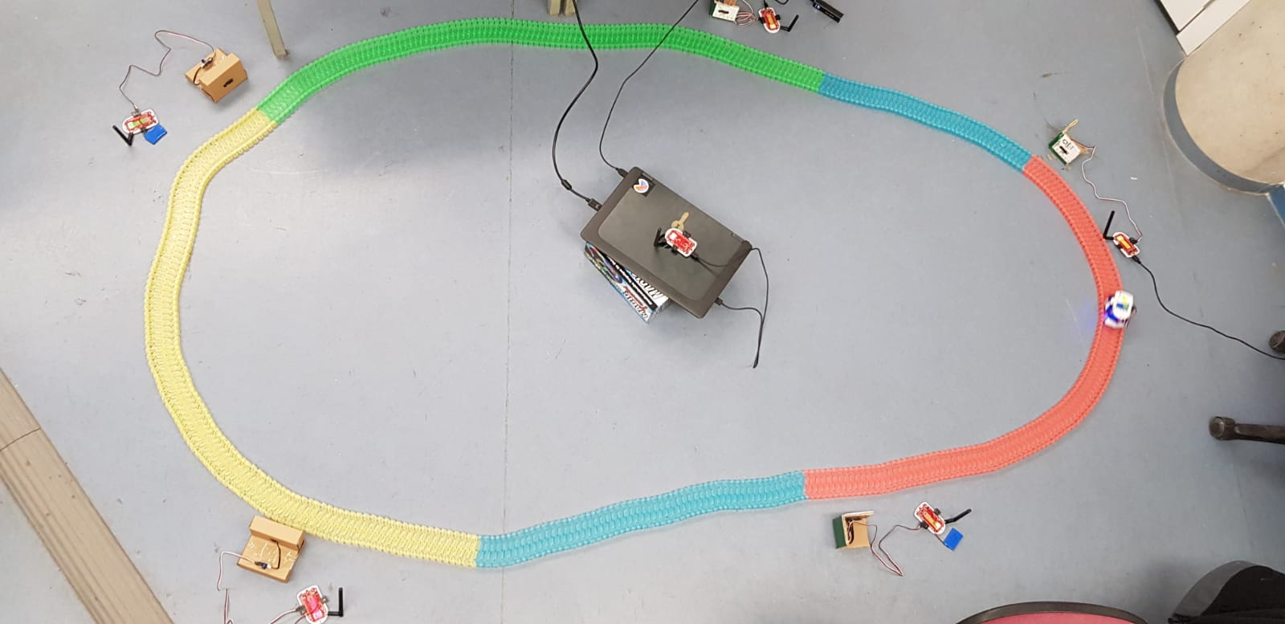
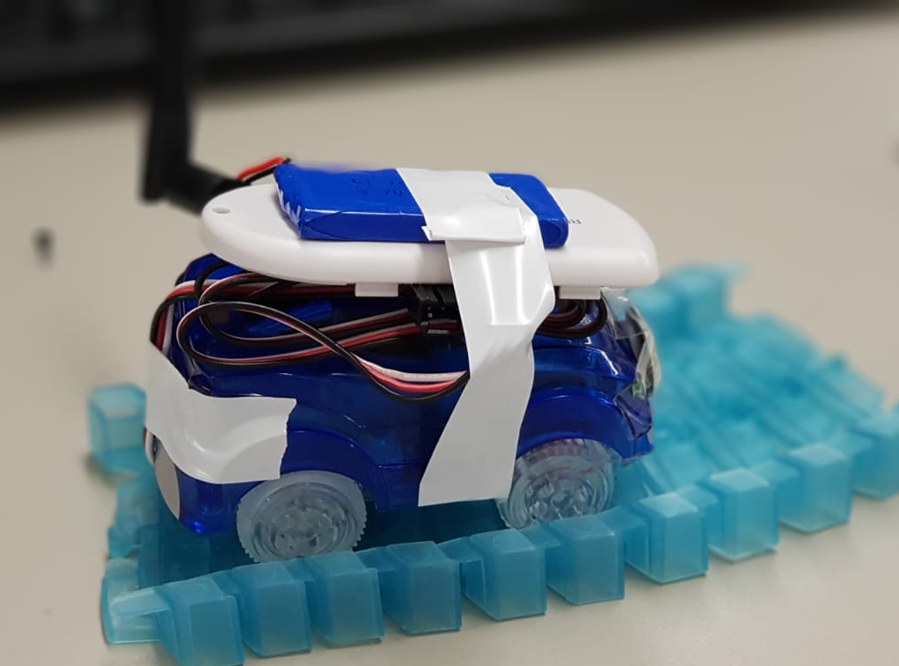
Projects
Wireless Sensor Networks (Winter 18)
Intelligent Transportation System with Wireless Sensor Networks
Source: https://github.com/gundoganalperen/
Notes:
For wireless sensor networks course, we designed .....
Simply, we had a circular road with road side units and mobile units. Road side units have distance sensors so that they can understand when a car passes through their section and Mobile units have force sensors. The idea is to monitor the positions of the car on the road through distance sensors on RSUs and when there is a car collision, these RSUs are used as a relay to inform other other vehicles and traffic control center.

Slide 6
Projects
Research Proposal (Winter 18)
Deep Reinforcement Learning based Resource Management for Cellular Vehicle-to-Vehicle Communication(C-V2V)
Training about AI
Machine Learning for Communications
Approximate Dynamic Programming and Reinforcement Learning
Applied Reinforcement Learning
Neural Networks and Deep Learning (Coursera)
Improving Deep Neural Networks: Hyperparameter tuning, Regularization and Optimization (Coursera)
Notes:
In that time, I was focusing on the communication among vehicles. I have completed my internship about V2X and WSN. For one of my lecture, I have proposed a resource proposal. In that time, application of machine learning and reinforcement learning were new in communication and there was a great potential on the applications of ML in Communication technologies. Especially, RL can be used for a resource management. Then, I proposed "deep reinforcement learning based resource management for V2V Com."
This proposal was actually a breaking point, then I got many lectures in the university both theoretical and application. I also completed online courses.

Slide 7
Projects
Applied Reinforcement Learning (Summer 19)
LIDAR based Obstacle Avoidance with Reinforcement Learning using Turtlebot
Source: https://github.com/gundoganalperen/
Notes:
I have worked in a project for "LIDAR ....",
We trained the policy in simulation and deploy trained policy in a real robot. Simply, the robot receives LIDAR data and determines the linear and angular velocity to avoid collision.

Slide 8
Master Thesis
Distributed Resource Allocation with Multi-Agent Deep Reinforcement Learning for 5G-V2V Communication
Autonomous resource allocation in the absence of a base station. Each vehicle is a learning agent.
Goal: Perform joint/cooperative behavior in a distributed fashion to utilize packet reception ratio.
Research Status
Workshop “Machine learning in the context of communication networks” at TUM (21.02.2020)
https://mlkuvs.lkn.ei.tum.de
Mobihoc 2020 (submitted)
IEEE Transactions on vehicular communication (Expected)
Resource 1
Resource 2
Resource 3
Resource 4
Resource 5
Notes:
I eloborated the research proposal that I wrote for the lecture and proposed to the company as a master thesis. They allowed me to work on this project in the company. My thesis is about "Distributed ....".
I designed autonomous resource allocation mechanism in the absence of a base station. Each vehicle is a learning agent and decides which resources to use based on local observations.
The goal is to perform a joint/cooperative behaviour in a distributed fashion to utilize packet reception ratio.
%In that time, we were working on a V2X project,

Slide 10

Questions?

